Slide 1
Customer Retention Case Study

Slide 2
INTRODUCTION:-
E-retail factors for customer activation and retention: A case study from Indian e-commerce customers
Customer satisfaction has emerged as one of the most important factors that guarantee the success of online store; it has been posited as a key stimulant of purchase, repurchase intentions and customer loyalty. A comprehensive review of the literature, theories and models have been carried out to propose the models for customer activation and customer retention. Five major factors that contributed to the success of an e-commerce store have been identified as: service quality, system quality, information quality, trust and net benefit. The research furthermore investigated the factors that influence the online customers repeat purchase intention on the basis of the means end chain theory (MEC) and prospect theory. By hypothesizing that a combination of both utilitarian value and hedonistic values are needed to affect the repeat purchase intention (loyalty) positively, structural equation model has been presented on the primary data collected from the Indian online shoppers. Results indicate the e-retail success factors, which are very much critical for customer satisfaction. By increasing the utilitarian value and hedonistic values derived by the customers, customer satisfaction and hence the customers repeat purchase intention can be increased significantly.

Slide 3
PROBLEM STATEMENT :- Result indicate the e-retail success factors, which are very much critical for customer satisfaction. So, through data analysis we have to find out is i true or not.
we have hypothesis assumption here:-
Ho. :- E - Retail success factor which is critical for customer satisfaction. It means that e- retail progress graph is high if customer is satisfied with the given services. If it is true null hypothesis[Ho.] is accepted and alternative hypothesis[H1.] is rejected.
H1. :- If the null Hypothesis[Ho] is rejected then it automatically accepted the alternative hypothesis[H1].

Slide 4
Graphical representation for explanation
In this it shows the actual figure and perspective of problem statements. Every feature columns in data set are contributing for problem but we see features which has strong correlation and highest contribution. Although there are different types of graph we see in further slides

Slide 5
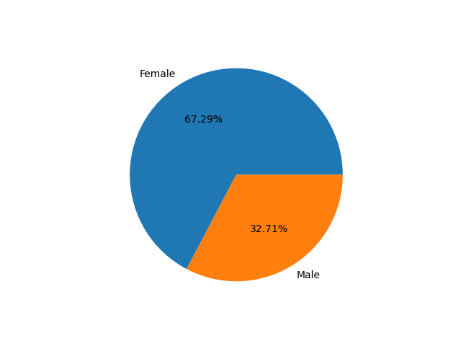
Gender of respondent
1:-180 ,0:-89
In the above figure it shows how many male and how many females are respondent in online shopping , and we see that male respondent are more than female or we can say male respondent are almost double than female.

Slide 6
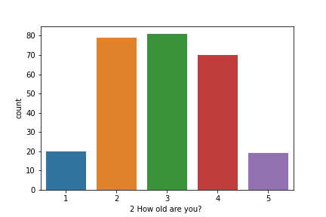
How old are you?
3:- 81, 2:-79, 4:-70,1:-20, 5:-19
In here there are 4 categories are there 2 and 3 here are the people in early 20s and early 30s.
while 4 is late 30s to 40+ of age and 5 is over 50. Although 1 is starting age respondent which is less than 20
Categories 2,3 and 4 have majority of respondent

Slide 7
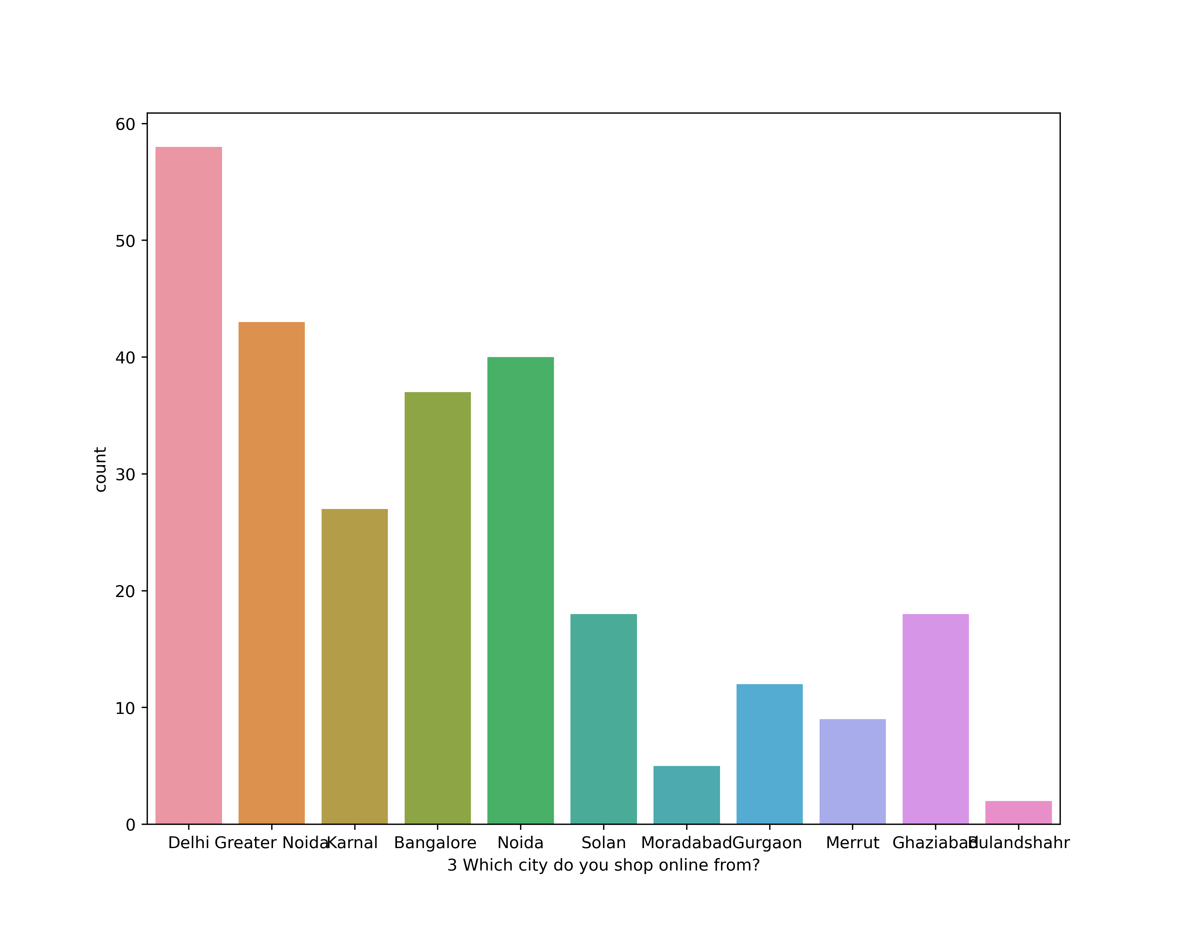
Which city do you shop online from
1 Delhi 58
2 Greater Noida 43
3 Noida 40
4 Bangalore 37
5 Karnal 27
6 Solan 18
7 Ghaziabad 18
8 Gurgaon 12
9 Merrut 9
10 Moradabad 5
11 Bulandshahr 2
All most of city Delhi , Greater Noida , Noida and Bangalore were the first 4 highest city where people shop most from online

Slide 8
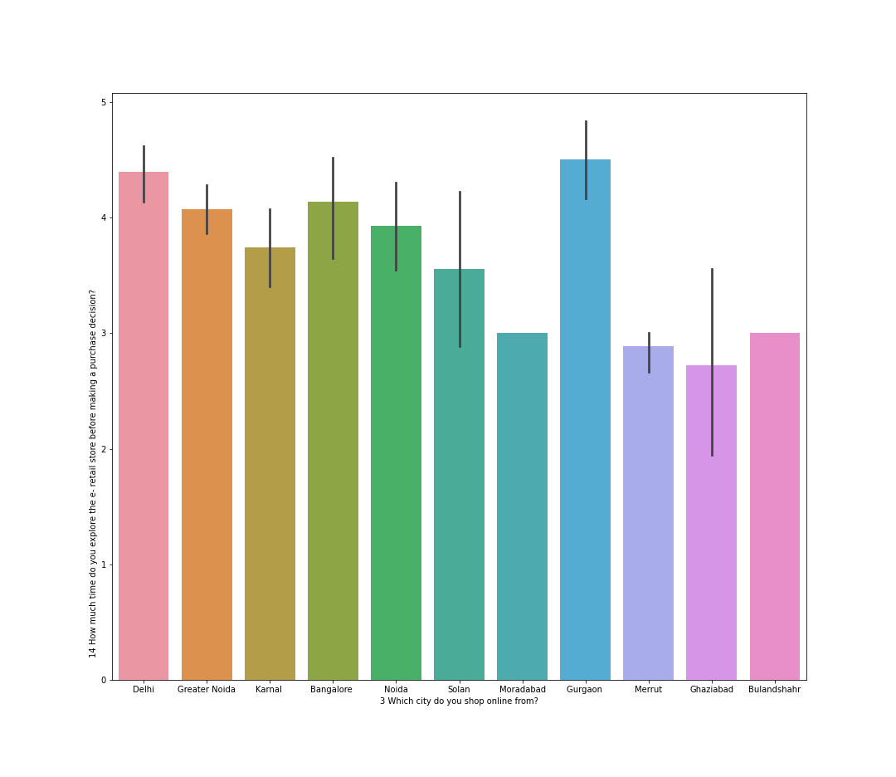
CITY vs TIME BEFORE MAKING PURCHASES DECISION
Here we see that city is in x-axis show and time before make purchases in y-axis
Gurgaon has the sort of highest no of responder which take lots of time making purchases
Delhi is in second and then Bangalore

Slide 9
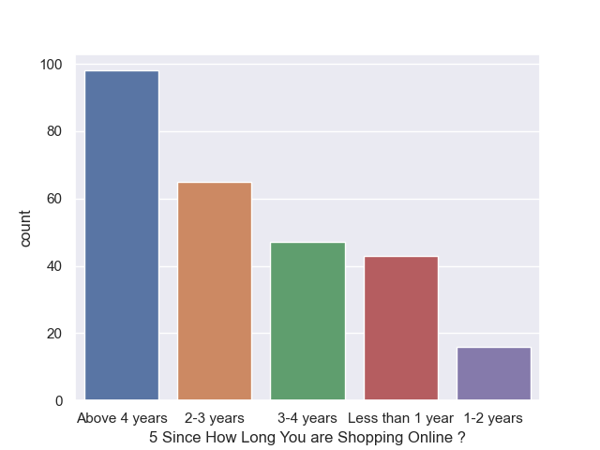
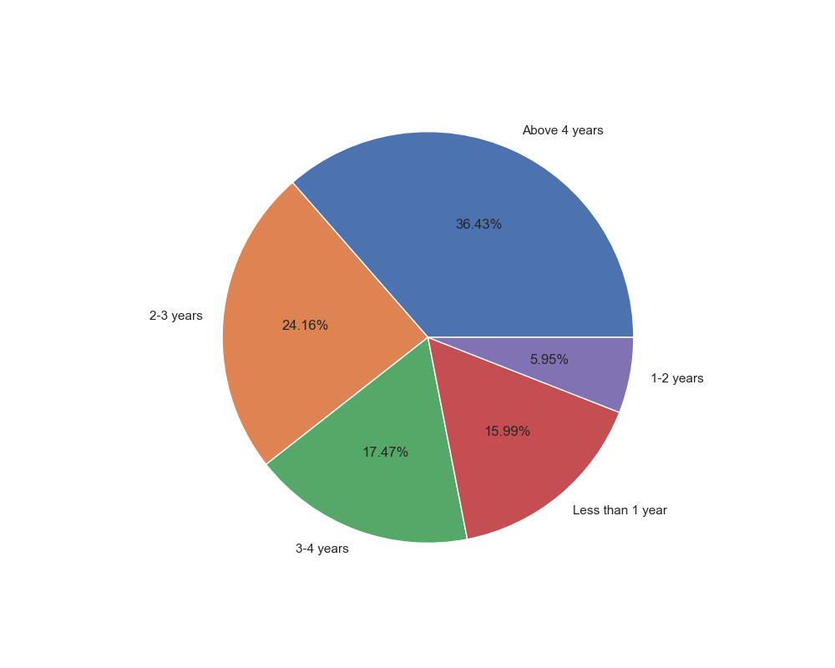
Since How Long You are Shopping Online ?

Slide 10
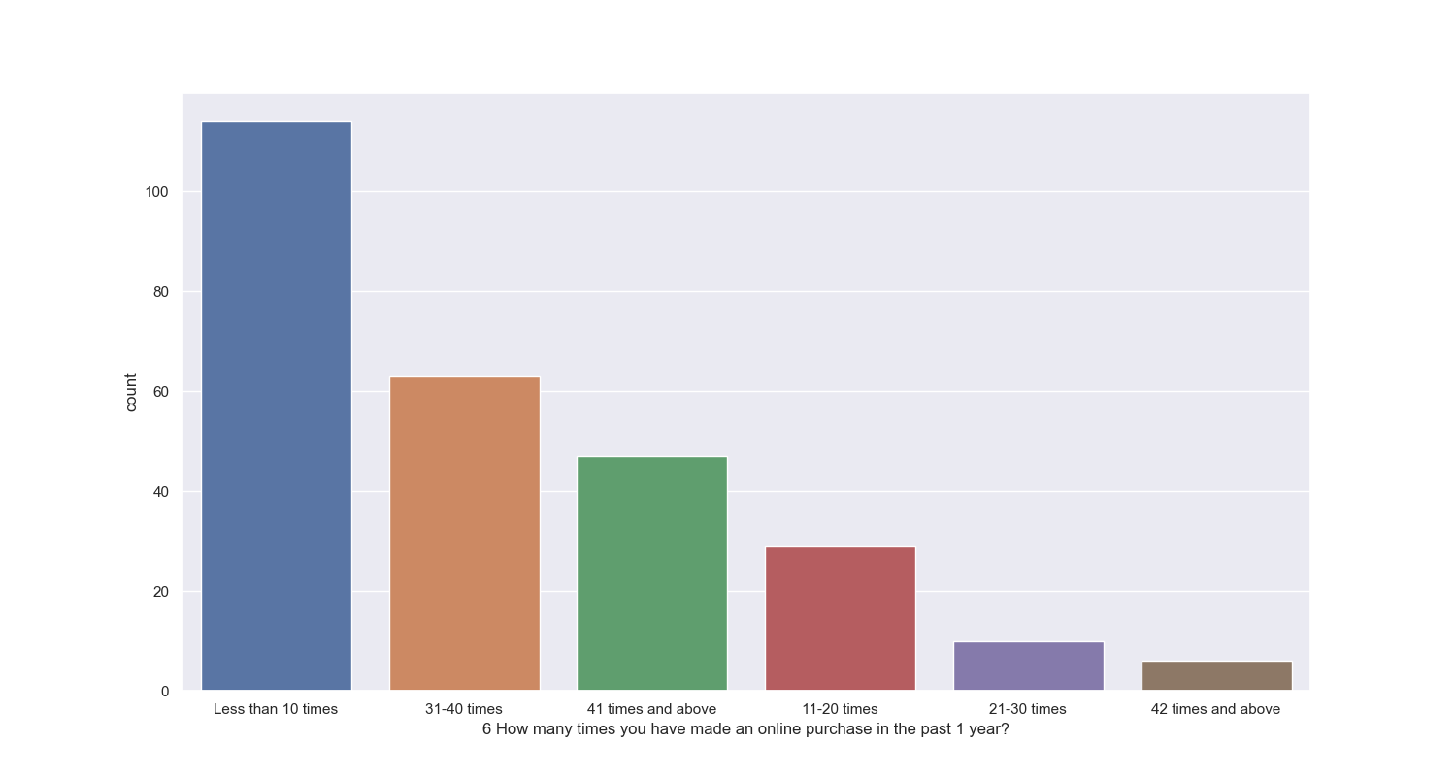
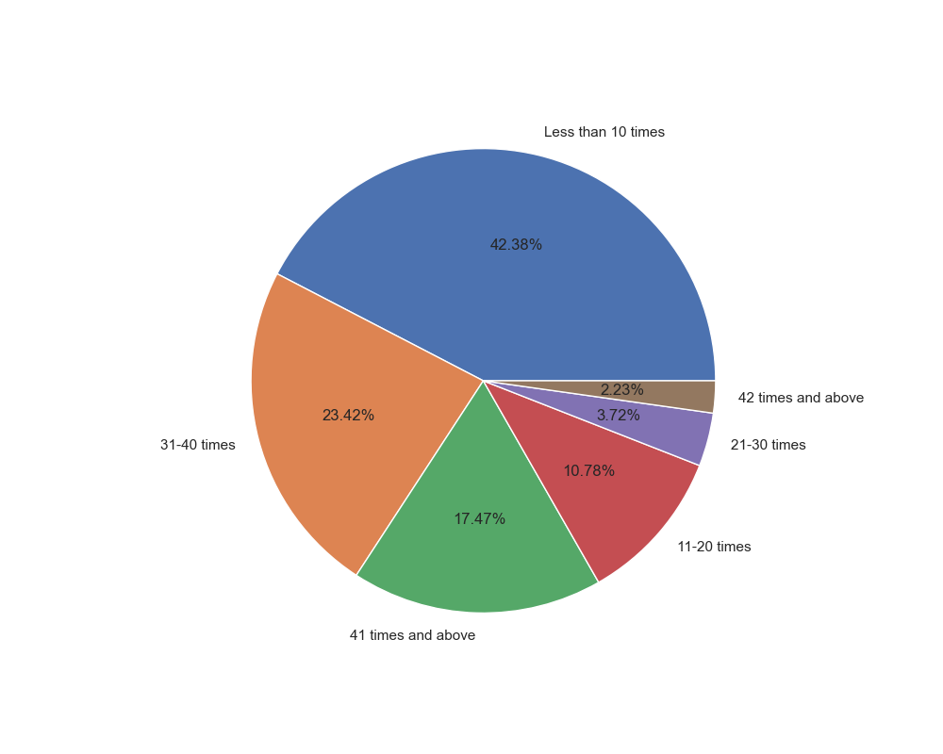
How many times you have made an online purchase in the past 1 year?

Slide 11
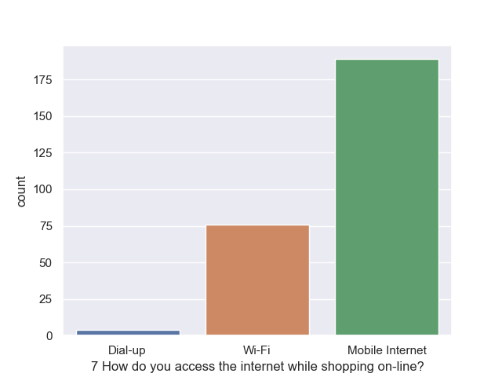
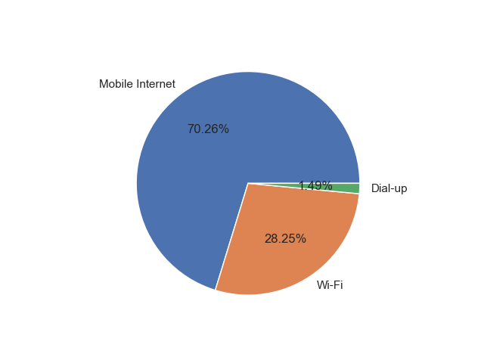
7 How do you access the internet while shopping on-line?

Slide 12
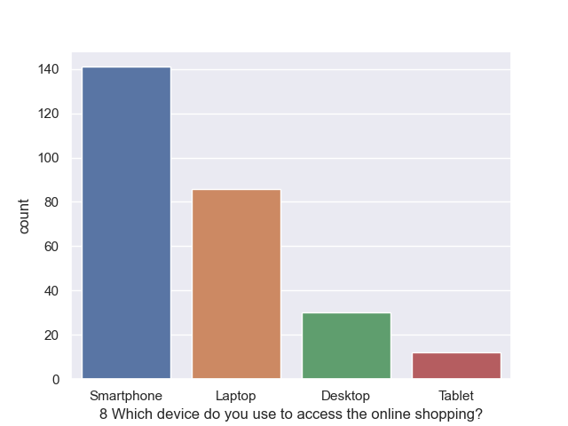
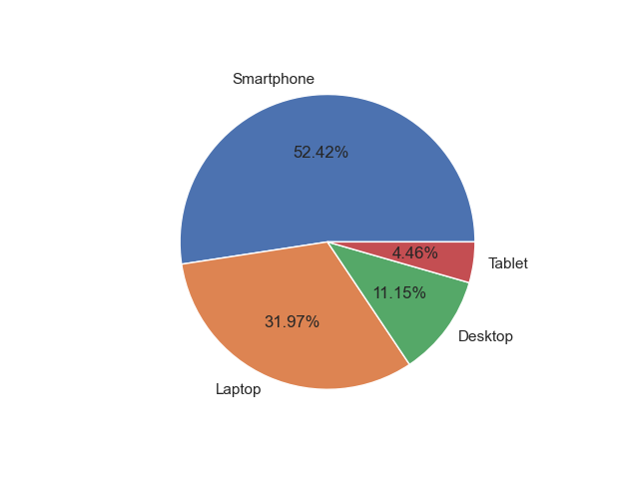
Which device do you use to access the online shopping?

Slide 13
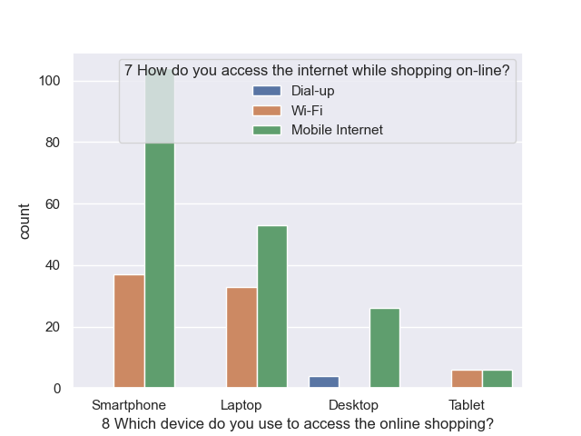
Access of internet and device used for shopping

Slide 14
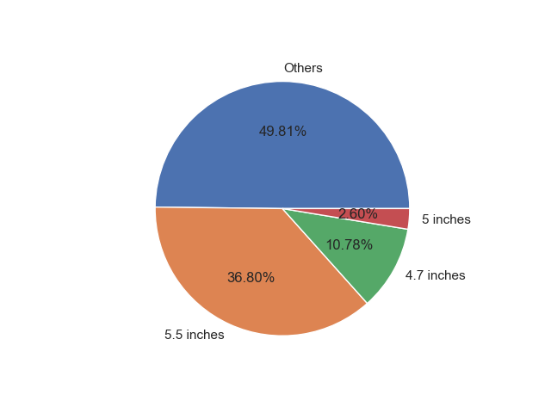
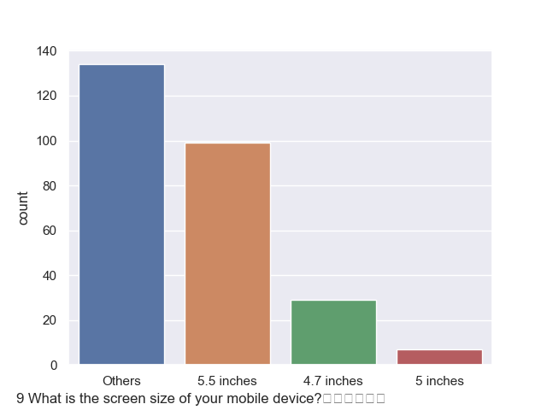
What is the screen size of your mobile device?

Slide 15
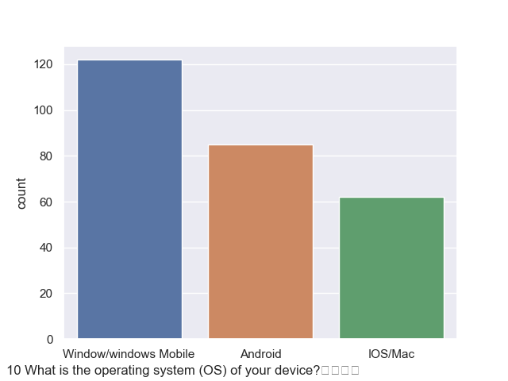
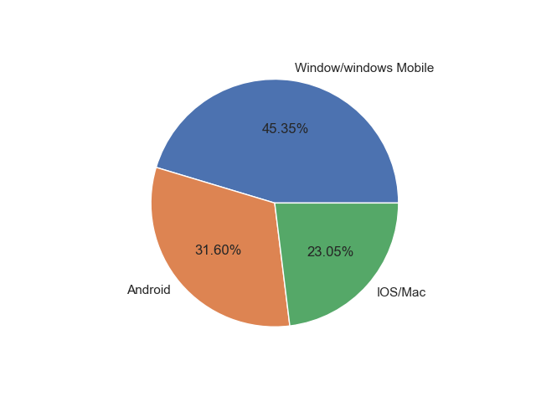
What is the operating system (OS) of your device?

Slide 16
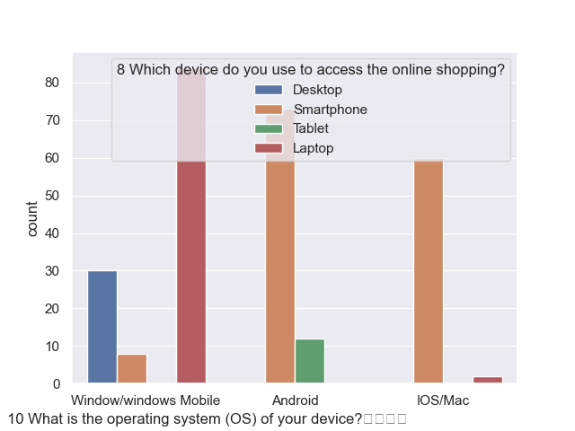
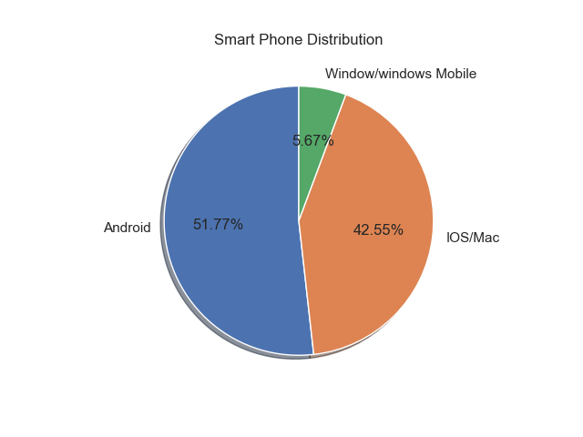
Which device do you use for online shopping &operating system of device
When we see that the distribution of smart phone with the operating system
Android is has 51.77% which highest among all other.
Windows mobile or window operating system laptop are frequently used for online shopping .
Although Android is also used with high proportion.

Slide 17
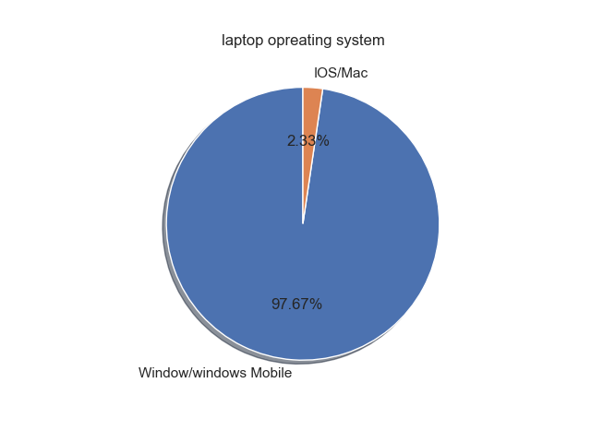
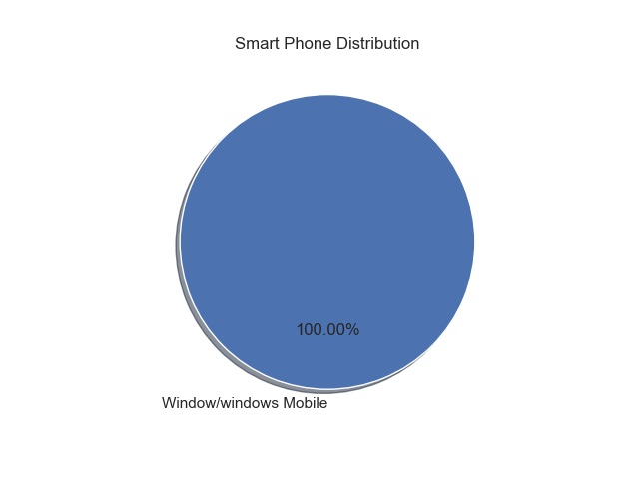
Device and its operating system

Slide 18
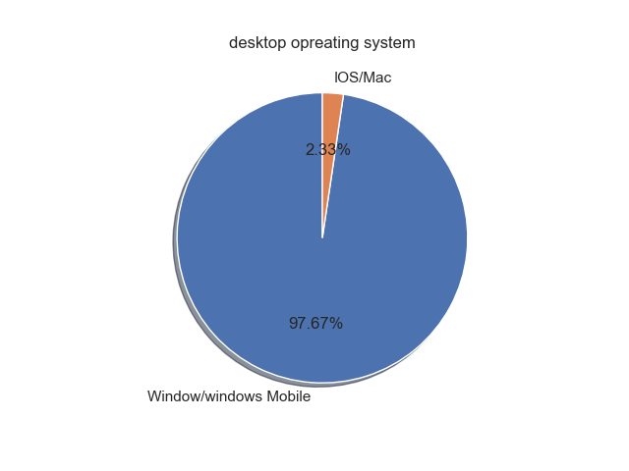
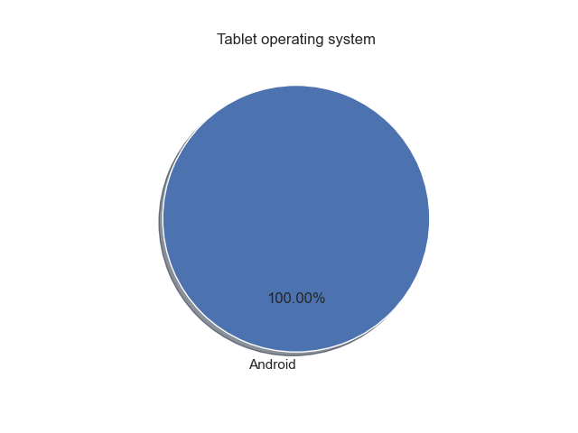
Device and its operating system

Slide 19
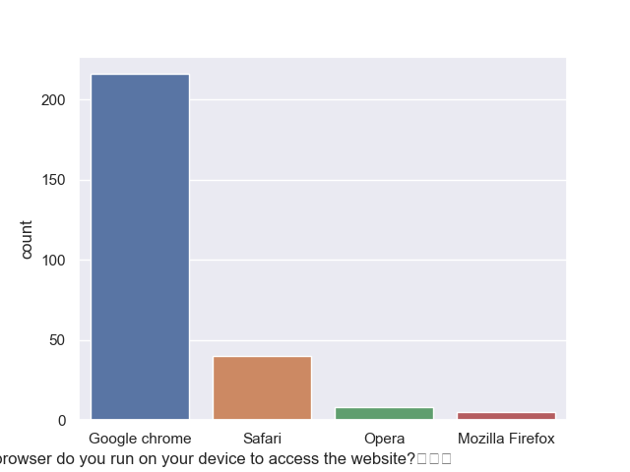
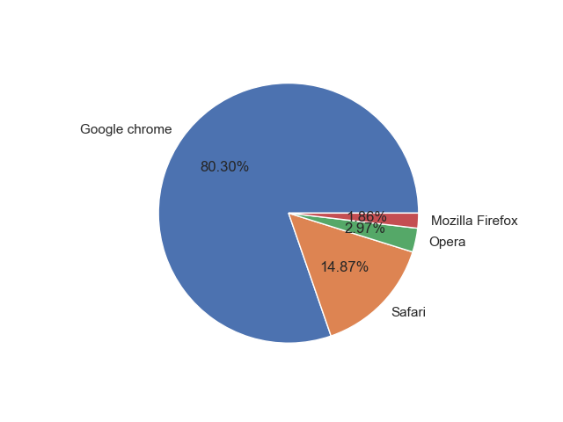
What browser do you run on your device to access the website

Slide 20
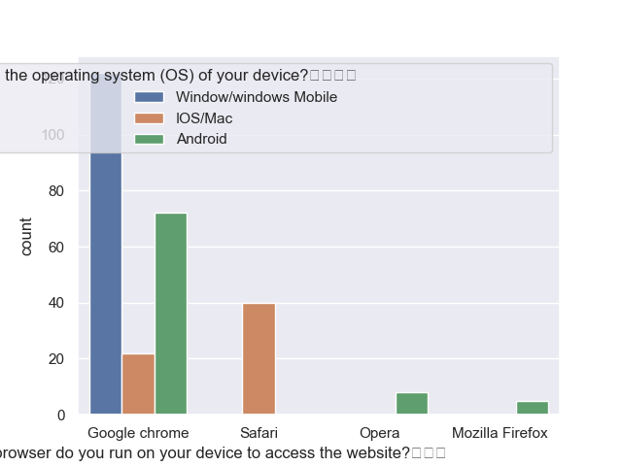
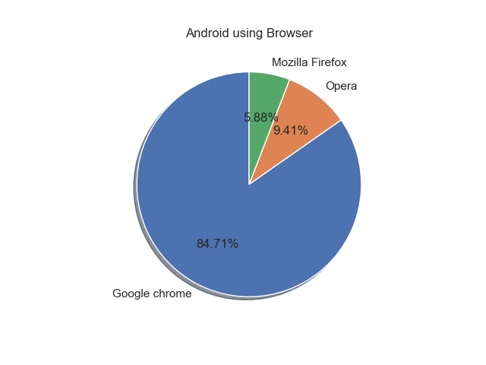
Operating system and Browser used to access

Slide 21
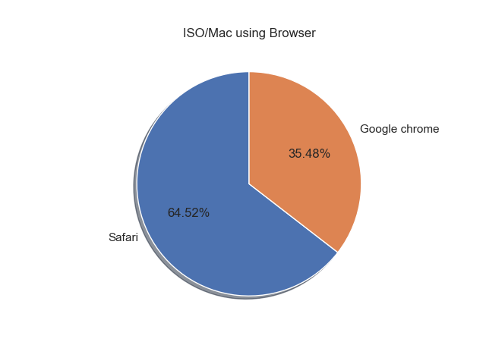
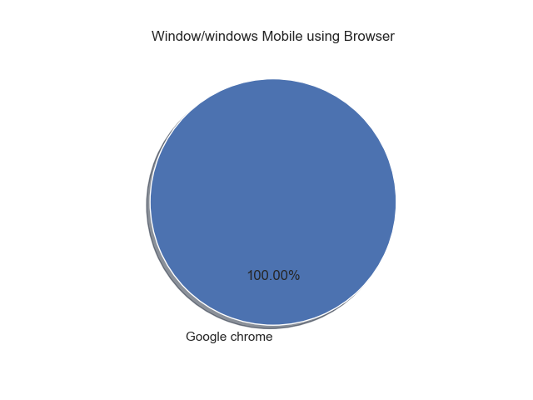
Operating system and Browser used to access

Slide 22
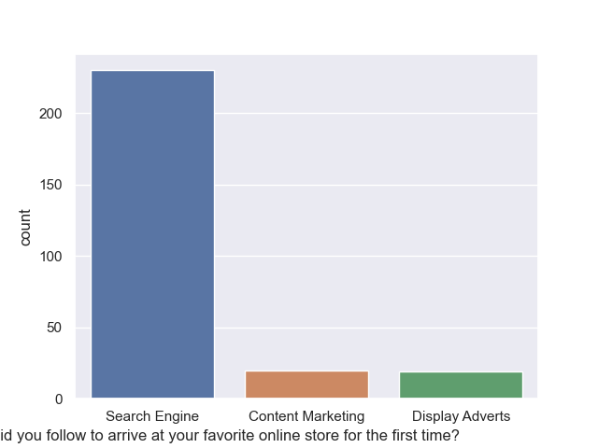
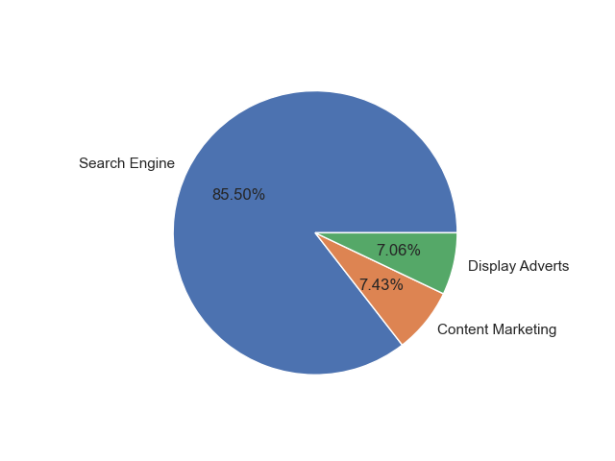
Which channel did you follow to arrive at your favorite online store for the first time
Search engine is followed .Yes, with very high proportion

Slide 23
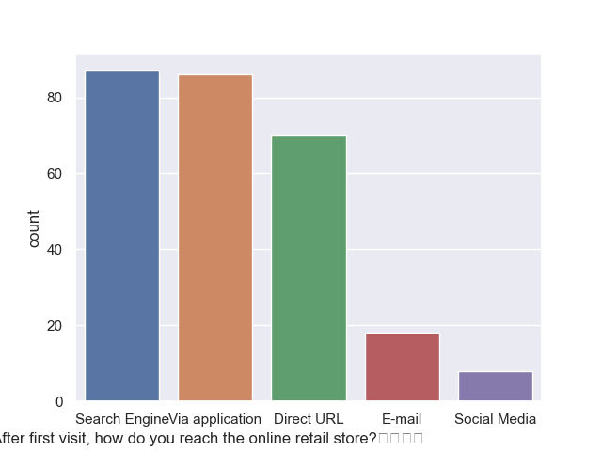
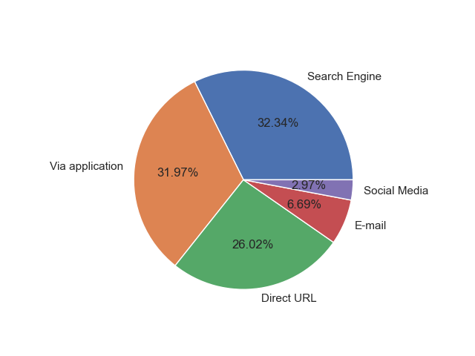
After first visit, how do you reach the online retail store?
In this case search engine and via application took more than half the circle

Slide 24
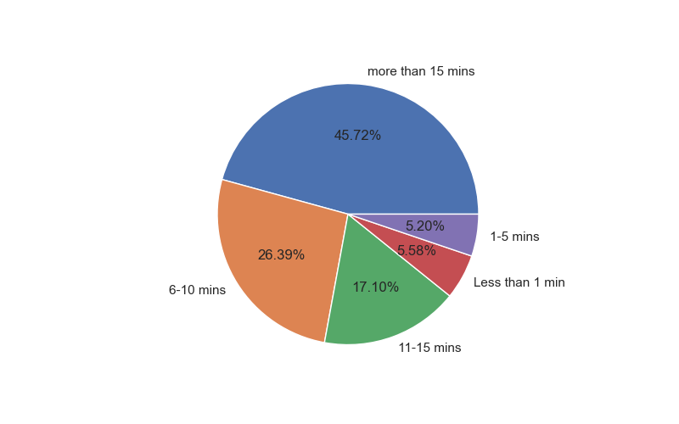
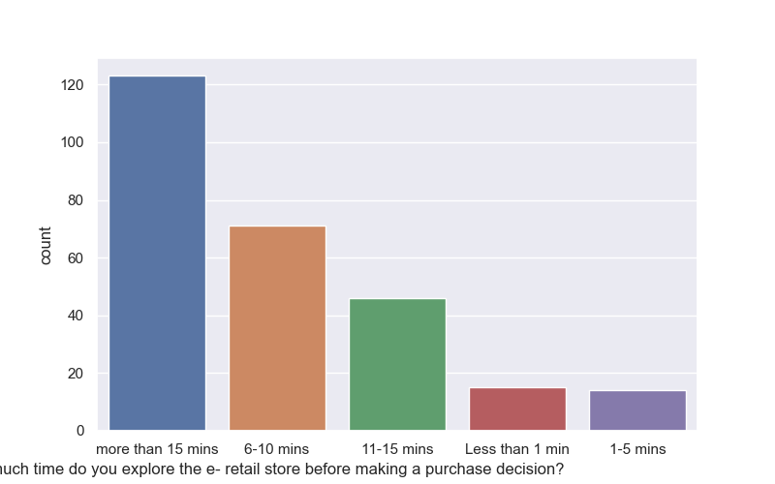
How much time do you explore the e- retail store before making a purchase decision?
There are high no. of people who explore more than 15 mins
Very less no. of who explore less than 1 min

Slide 25
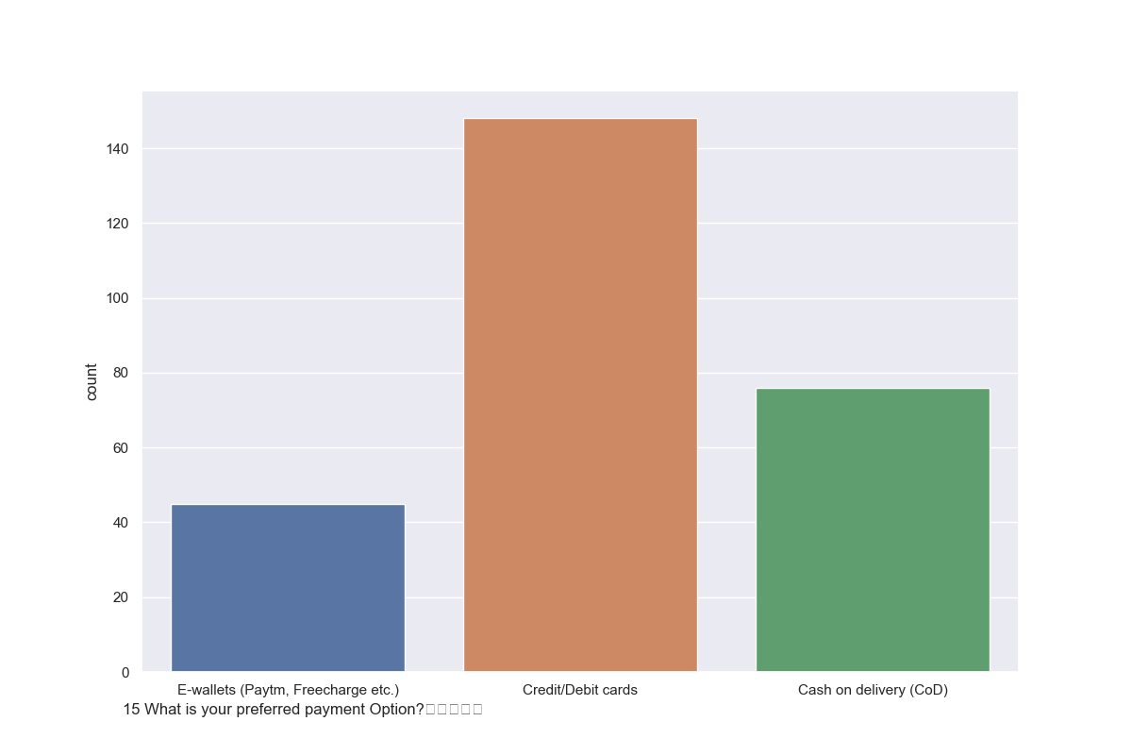
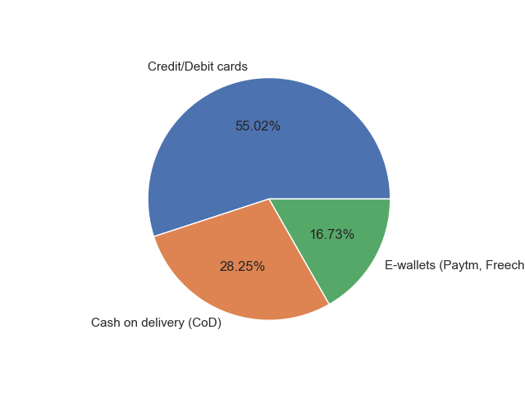
What is your preferred payment Option
Most people choose to pay through card
Other cash on delivery , while 16.73% shall use E-wallets

Slide 26
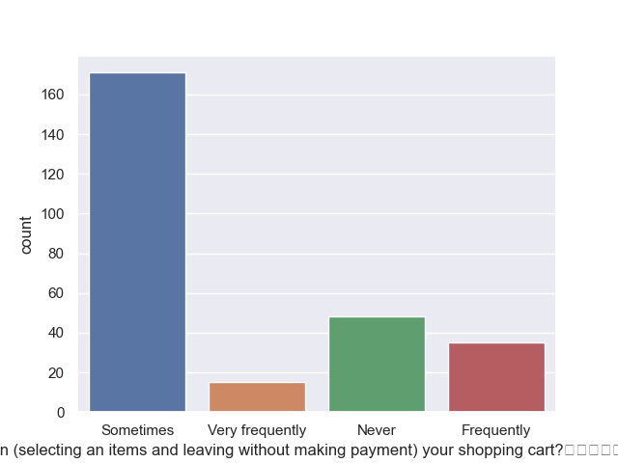
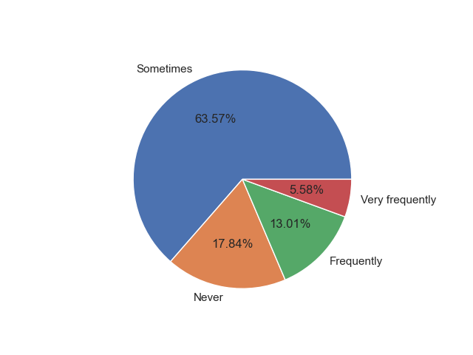
How frequently do you abandon (selecting an items and leaving without making payment) your shopping cart
Some times people abandon the shopping cart
Although there are also kind of customer who frequently and very frequently left the cart they are approx. 19%

Slide 27
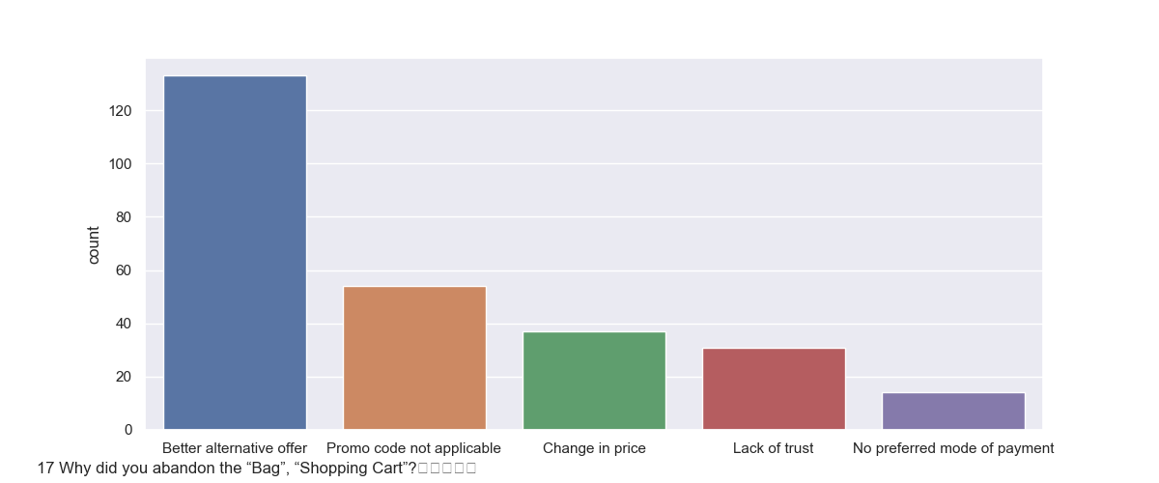
Why did you abandon the “Bag”, “Shopping Cart”
People getting better offer and most of them abandon the Bag

Slide 28
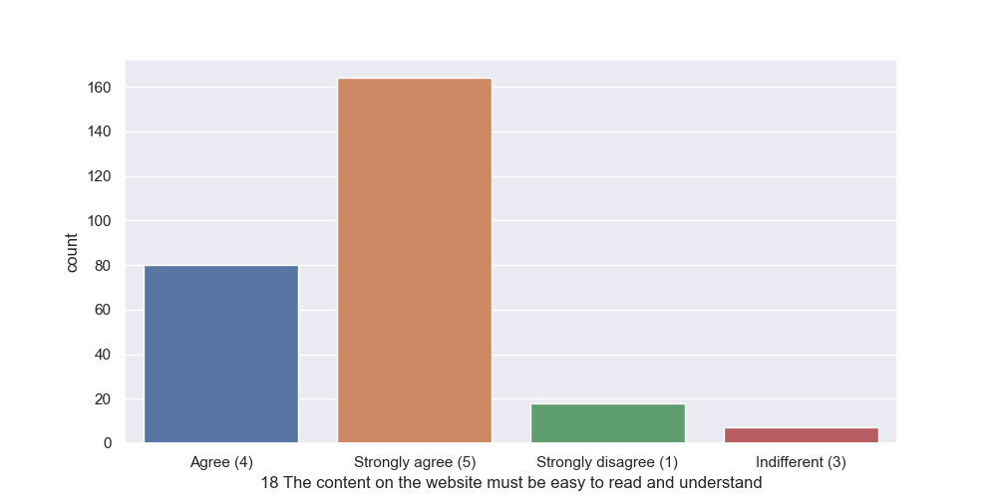
The content on the website must be easy to read and understand

Slide 29
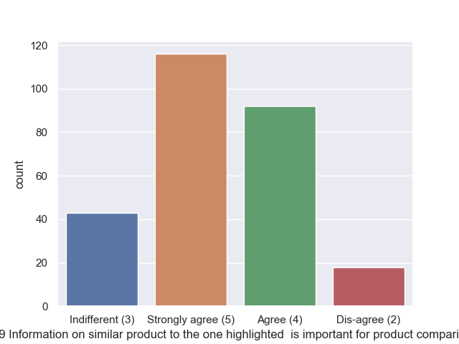
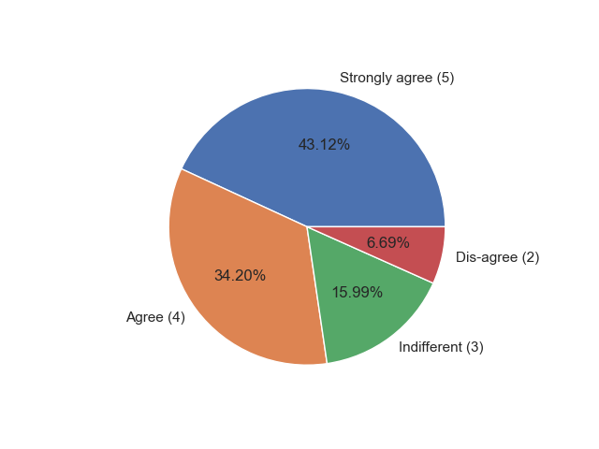
Information on similar product to the one highlighted is important for product comparison

Slide 30
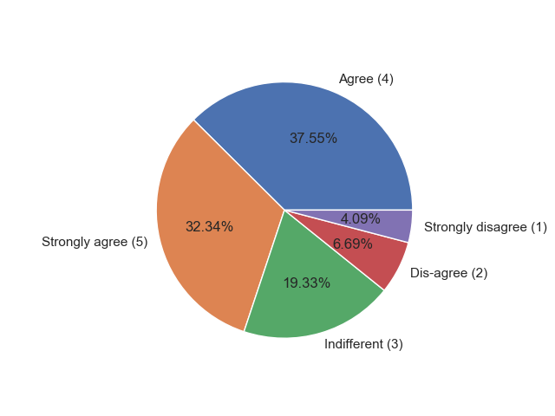
Complete information on listed seller and product being offered is important for purchase decision

Slide 31
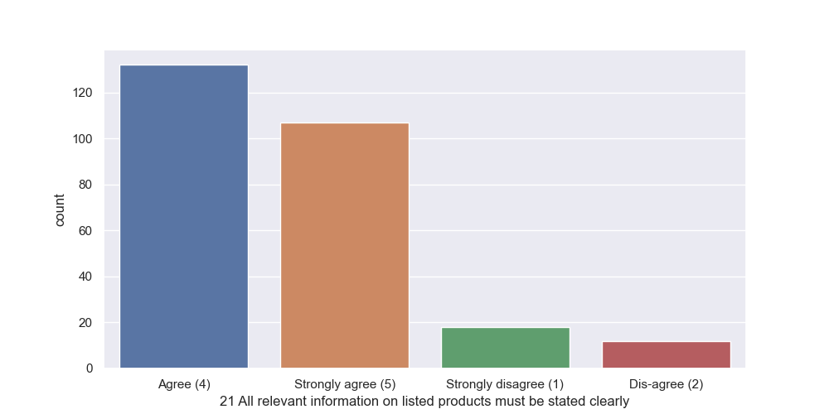
All relevant information on listed products must be stated clearly

Slide 32
Ease of navigation in website

Slide 33
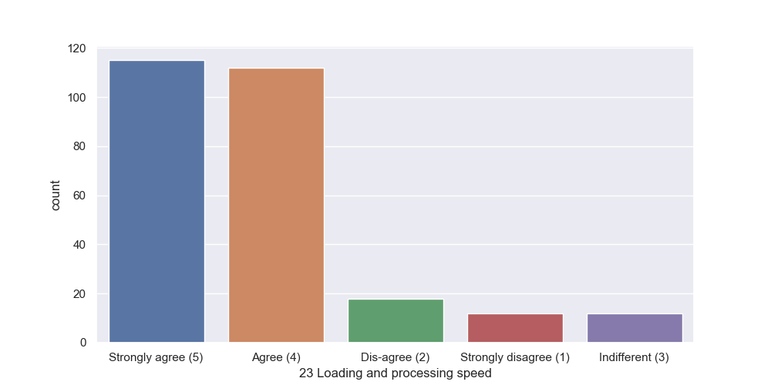
Loading and processing speed

Slide 34
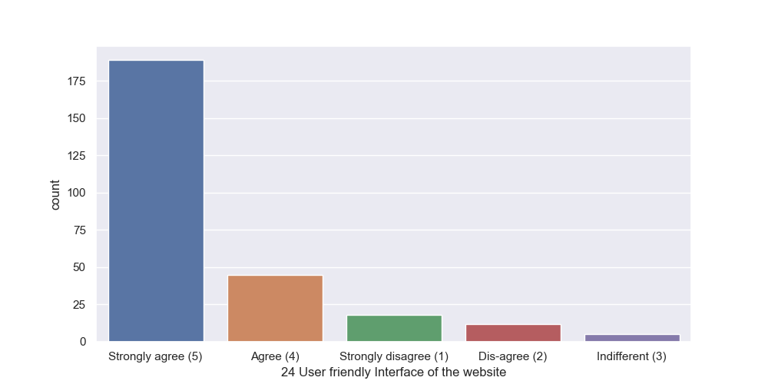
Convenient Payment methods

Slide 35
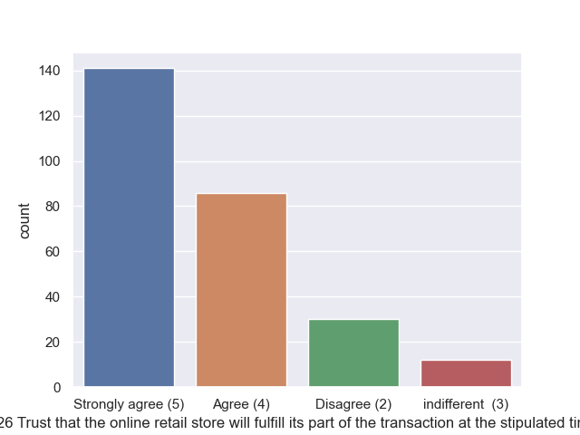
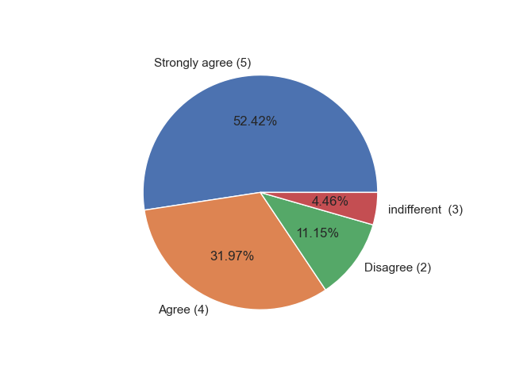
Trust that the online retail store will fulfill its part of the transaction at the stipulated time

Slide 36
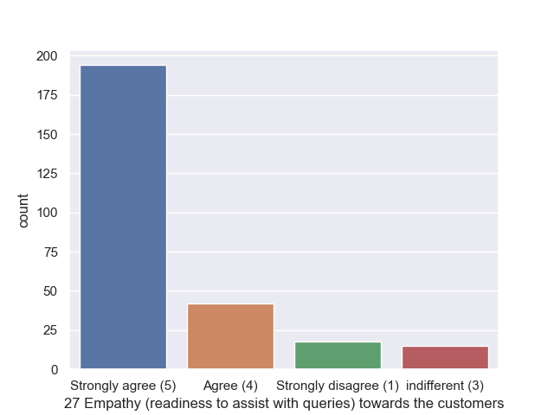

Empathy (readiness to assist with queries) towards the customers

Slide 37

Being able to guarantee the privacy of the customer

Slide 38

Responsiveness, availability of several communication channels email, online rep, twitter, phone etc.

Slide 39


Online shopping gives monetary benefit and discounts

Slide 40

Enjoyment is derived from shopping online

Slide 41


Return and replacement policy of the e-tailer is important for purchase decision

Slide 42

Gaining access to loyalty programs is a benefit of shopping online

Slide 43

Displaying quality Information on the website improves satisfaction of customers

Slide 44

User derive satisfaction while shopping on a good quality website or application

Slide 45

Shopping online is convenient and flexible

Slide 46
Return and replacement policy of the e-tailer is important for purchase decision

Slide 47
Gaining access to loyalty programs is a benefit of shopping online

Slide 48
Displaying quality Information on the website improves satisfaction of customers
Quality is important for customer satisfaction

Slide 49
User derive satisfaction while shopping on a good quality website or application
Definitely customer voted in strongly agree ,cause for quality purpose

Slide 50

Net Benefit derived from shopping online can lead to users satisfaction
Strongly agree has highest vote

Slide 51


User satisfaction cannot exist without trust
Strongly agree reviewed by customer is 45.35%
And agree is 43.49%
Customer review is positive in this feature

Slide 52

Offering a wide variety of listed product in several category

Slide 53

Provision of complete and relevant product information

Slide 54

Monetary savings

Slide 55

The Convenience of patronizing the online retailer

Slide 56

Shopping on the website gives you the sense of adventure

Slide 57


Shopping on your preferred e-tailer enhances your social status

Slide 58

You feel gratification shopping on your favorite e-tailer

Slide 59

Shopping on the website helps you fulfill certain roles

Slide 60

Getting value for money spent

Slide 61

Easy to use website or application

Slide 62

Which retailer you have shopped
Amazon and Flipkart took half of circle ,also in this Amazon has highest proportion
And other half is taken by Myntra Paytm and Snapdeal

Slide 63

Visual appealing web-page layout choices
Appealing web page layout choices as per reviewed Amazon
And Flipkart
And then Myntra and Paytm and Snapdeal

Slide 64

Wild Variety of Product on Offer
Amazon and Flipkart obviously having wild variety
Other than that we see Myntra also have wild variety as per customer review

Slide 65

Complete, relevant description information of products
Customer should vouch for this point for Amazon and Flipkart
And then any other of them

Slide 66

Fast loading website speed of website and application
Amazon and Myntra has fast loading website and application
After that Paytm ,Myntra and Snapdeal

Slide 67

Reliability of the website or application
It seems that customer are most reliable using amazon
Flipkart comes next
People is reliable using Paytm, it’s a good review
And very less customer is chosen the Myntra and Snapdeal

Slide 68

Quickness to complete purchase
In this feature
Flipkart is in top as reviewed
Second is Paytm and then Myntra
Then Snapdeal and Amazon
which is almost 0.00%

Slide 69

several payment options
Several payment option
1.Amazon
2.Flipkart
3.Myntra
4.Snapdeal
5.Paytm

Slide 70

Speedy order delivery
Speedy order delivery Amazon is reviewed as good
Flipkart is second as review
Myntra is delivery is not speedy
Snapdeal is reviewed more than Myntra

Slide 71

Privacy of customer information
Privacy of customer information is good in Amazon and Filpkart
Myntra is reviewed as very low in privacy, this very concern point as it reviewed.

Slide 72

Security of customer financial information
Amazon and flipkart are the two which seen as good in security of customer financial information

Slide 73

Trustworthiness
In trustworthiness we see Amazon is the highest
Second is Flipkart as per customer review
Paytm is reviewed as very less trustworthiness
Although Myntra and Snapdeal is also lowest

Slide 74

Longer time to get logged in
Most of customer is logged in in amazon for longer time in compared to other
Flipkart is voted second
Lowest vote is given to Myntra

Slide 75

Longer time in displaying graphics and photos
In this case we see amazon has highest proportion
Lowest is the Paytm
Snapdeal and flipchart is almost same
Myntra is second last in number

Slide 76

Late declaration of price
Late declaration of price is almost same for all the E-online shopping company
Although Paytm has highest proportion
Flipkart has lowest proportion

Slide 77

Limited mode of Payment on most products
Amazon and snapdeal has limited mode of payment on most of product
Almost all kind of payment mode is present in myntra
For flipkart and paytm not all mode but regular mode of payments are present

Slide 78

Longer Delivery period
Here we see the product delivered by the E-shopping company which took longer time period
As per data the longer delivery period is by Paytm and Snapdeal
Between Snapdeal and Paytm has difference of approx. 3%
Least longer delivery period is Myntra

Slide 79

Change in website/application design
Amazon has highest tendency of 43.93%
Flipkart has 22.43%
Paytm has 19.63%
Myntra has 11.53%
Snapdeal has lowest 2.49%
Snapdeal has change the website very less in compared to other.

Slide 80

Frequent distruption on page change
As per the distruption the amazon is highest
Second come at Snapdeal
Although there is very little difference between Amazon and Snapdeal

Slide 81

Website is as efficient as before
Amazon is more efficient as before shows 45.96%, almost half of the 100% .
At second the Flipkart holds at 29.55%
Myntra is not as efficient as per data

Slide 82
Conclusion
As per data is we view and analyzed it is pretty clear that if company wants to retain the customer the following points should matter Product
Quality matters and also its detail description with accumulated policy is what attract customer
Most of customer use card through payment , so it helps them to provide coupons and discounts and benefit for using card as payment option
Speedy delivery is one of advantage for retaining customer
Privacy and security of customer interest is seen to be important feature
There are lots of feature but these are seem important although , top most priority is to satisfied customer needs
And yes it seems like null hypothesis[Ho.] is accepted , that is if customer satisfaction with the given services is true then graph of E-retail is in upward direction

